Slide 1
QUEST- Quality Urban Energy Systems of Tomorrow
Smart Energy Communities &
Community Energy Planning
City of Charlottetown, January 18
Presented by Eddie Oldfield
Notes:
THIS IS THE BASIC TEMPLATE TO BE USED FOR OVERVIEW PRESENTATION FOR QUEST AND RECRUITING SUBSCRIBERS AND PLUS LEVEL SUPPORTERS
SLIDES CAN BE LOCKED OUT TO SUIT THE AUDIENCE -- HIGHLIGHTS REFLECT AREAS WHERE MODIFICATIONS WILL BE REQUIRED

Slide 2
Who Are We
QUEST is the leader in the development of Smart Energy Communities.
Operate 8 Provincial/Territorial Caucuses
Designated FCM Regional Climate Advisor (Atlantic)
Part of Generation Energy and long-term Canadian Energy Strategy
MOU signed with Natural Resources Canada to support the development of Smart Energy Solutions (e.g. micro-grids, CHP, DE, community energy planning)
Regional and National Working Groups engaging with government:
National District Energy Network (e.g., Building Codes and Standards Paper)
Smart Energy Leaders’ Dialogue (e.g., Generation Energy & EMMC2017)
Launched and finalizing Atlantic Canada Energy Data Roadmap
Support Government of Canada’s commitment to provide building and housing data by 2020

Slide 3
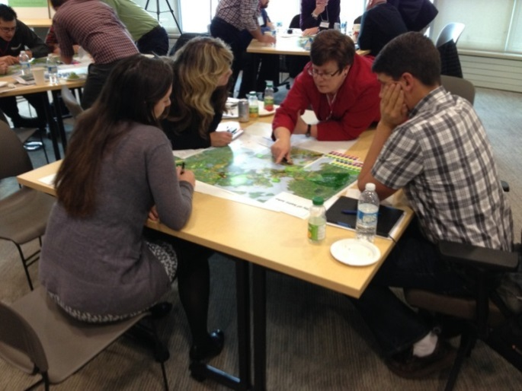
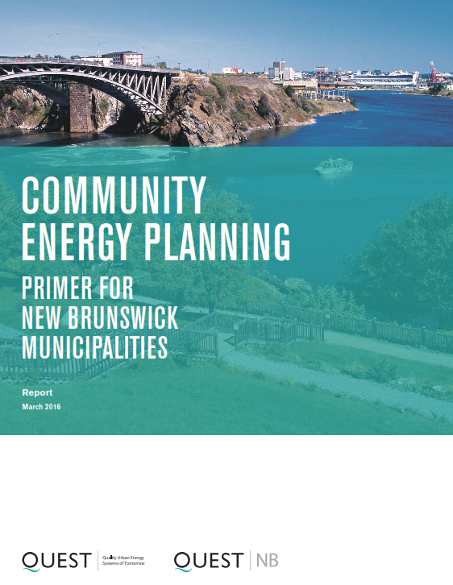
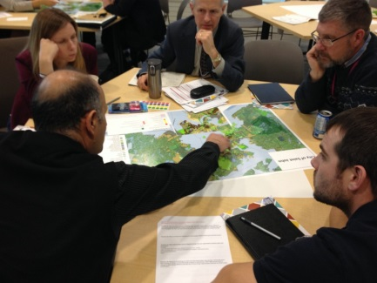
Impact
ADVANCING SMART ENERGY COMMUNITIES IN NB & PEI
50+ participants
Regional Workshops
Bilingual CEP Primer
Engaged NB+PEI Municipalities (47)
Established Municipal Working Group (15)
Won 2 Awards at QUEST 2017
Also provided input to governments on Actions contained in their Climate Change Action Plan and Energy Policy.

Slide 4
> Let’s Get to the Issue
In Atlantic Canada Communities account for 58% of energy use and 54% of GHGs
Action at the community level is required to meet PEI energy & climate objectives
Your participation is important to help your city become a Smart Energy Community.
Smart Energy Communities improve energy efficiency, enhance reliability, cut costs, and reduce greenhouse gas emissions.
Notes:
This is why focusing on energy use at the community level is so important.
Future considerations Carbon Pricing, Regulation, Pace of technological change, Cost reduction curve of technology
Communities are essential, but they can’t do it alone. Community energy planning is growing in Canada, with 384 communities with a CEP completed or in-development, representing over half of the population in Canada. The Smart Energy Atlas is an online repository of smart energy projects, policies, programs, plans, and resources in Canada.
Smart Energy Communities can help reach NEG ECP and NB targets for GHG reduction:
10% below 1990 by 2020
35% below 1990 by 2030
75% below 1990 by 2050

Slide 5
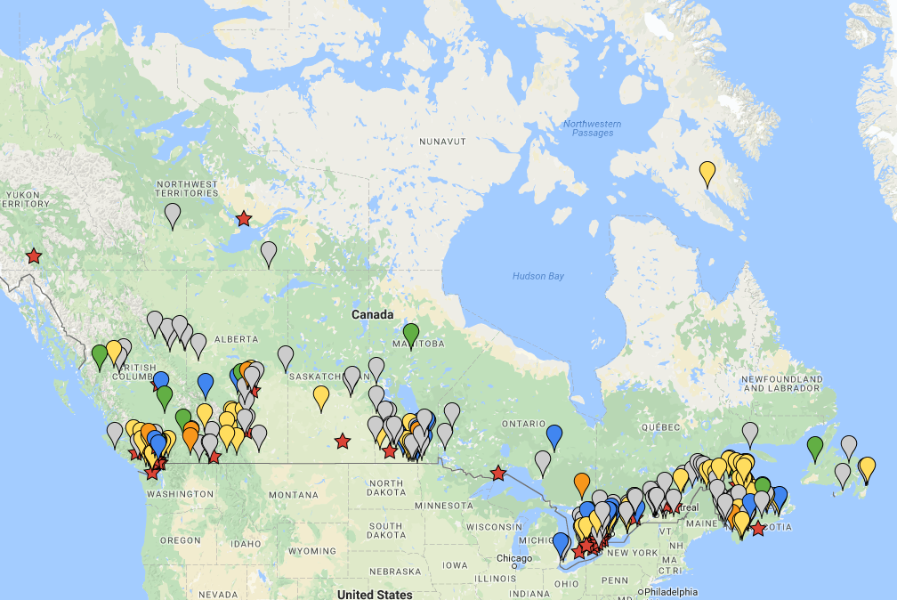
Partners for Climate Protection
A Canada-wide network…
Notes:
Many of them are members of the FCM PCP. In addition to CEP (QUEST 6 principles), a PCP Members’s CEP / Local Action Plan considers GHG emissions, not only from energy use, but also from waste, water, wastewater, and other sources.
By joining the PCP program, they are plugged into a network of leading local governments that are proactively working to mitigate GHGs and reduce the impact of climate change.
There are over 300 local government members within this network that represent every province and territory across Canada, with membership continuing to grow
The PCP network facilitates opportunities for participating local governments to get in touch with each other to share experiences, tools, best practices and advice.

Slide 6
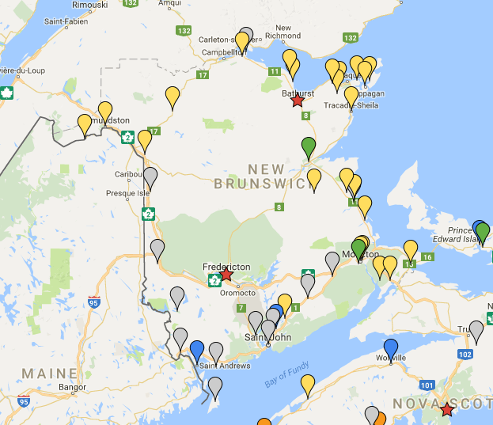
PCP
Milestone
MAP
Shift to EVs
Notes:
PCP members in NB
Circled ones are UMNB project – will have CEPs

Slide 7
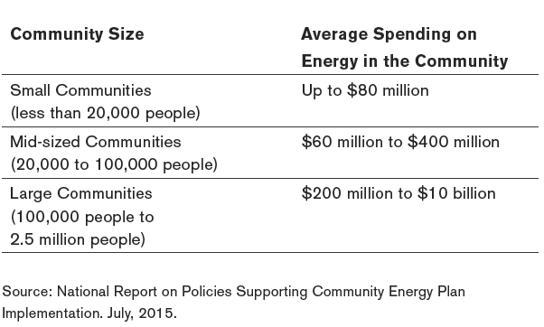
> It’s Not Just About Climate Change
The Average Cost of Energy in Canadian Communities
Notes:
Describe findings from (see slide)
On average, Per capita spending is 3 to 4000 in community
Investing in CEP, reduces the energy cost burden to municipalities, businesses, citizens.

Slide 8
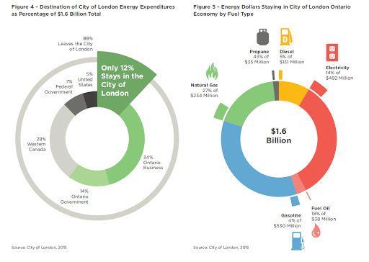
> CEPs Can Reduce Energy Costs
Notes:
Example: London, ON Community Energy Plan
Explain slide first. Then:
Energy Cost Avoidance of 250 Million per year by 2018.
Every 1% reduction in energy use kept $14 million in the local economy.
Investing in CEPs helps to reduce the energy cost burden in governments, businesses and homeowners.
Link to NB experience
With a CEP, SEC in NB can help reduce energy use, associated costs, GHG emissions, and keep energy dollars local.
Reducing even a small percentage of energy use, will help with balanced budgets and economic development in our communities.
11 municipalities in UMNB initiative. Aligned with other municipalities in NB, provincial and federal programs.

Slide 9
> What are the Benefits of a CEP
By accelerating CEPs provinces can more effectively:
Reach energy conservation and GHG emissions reduction targets (e.g. 40% by 2030, 100% by 2050)
Drive economic development and diversification
Accelerate alternative energy resource development
Achieve local energy affordability, security and resilience
Foster innovation and clean-technology development
Improve the integration of energy and local planning
Notes:
In one of our most recent reports, “Policies to Accelerate Community Energy Plans: an analysis of British Columbia, Ontario and the Northwest Territories” it was discovered that by accelerating CEP implementation, provincial and territorial governments can more effectively:
Reach energy conservation and GHG emissions reduction targets
Drive economic development and diversification
Accelerate alternative energy resource development
Achieve local energy affordability, security and resilience
Foster innovation and clean-technology development
Improve the integration of energy planning among provincial and territorial and local stakeholders

Slide 10
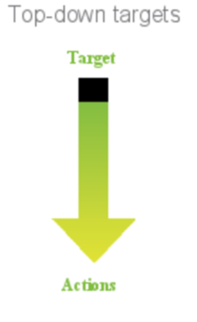
Municipal (corporate) CO2 emissions - baseline
All GHG emissions sources under direct control
e.g. buildings, streetlights, fleet vehicles, water/wastewater, waste.
For all energy / fuel types.
Buildings and Pump Stations
Tonnes CO₂
100
Water & Sewage 20% 424 Tonnes CO₂
5457 GJ
200
Vehicle Fleet 27 % 560 Tonnes CO₂
8014 GJ
Buildings 50% 1049 Tonnes CO₂
13490 GJ
550
Fleet
(560)
Notes:
M1
DIY – Do it yourself
Use the PCP Tool, or
Work with a Champion
Hire a consultant / Join a multi-municipal project
M2 – targets – 20% corporate, 6% community. Top Down or Bottom Up, or Both. Can compare low, mid, high targets.

Slide 11
Community-wide CO2 emissions - baseline
Town of Quispamsis
Population: 17886
Simple Zoning Legend:
Residential Commercial
Industrial Park/Green Space
N
N
GHG emissions from Residential, Commercial, Industrial, Institutional sectors, for all energy sources, as well as Transportation, Waste
Transportation 52% 67495 Tonnes CO₂
967078 GJ
Residential 40% 52205 Tonnes CO₂
685016 GJ
Commercial 7% 9098 Tonnes CO₂
121248 GJ
8.5
Tonnes CO₂
Average per dwelling
Notes:
Factors to consider when setting a community GHG target
Energy and emissions sources, factors, BAU
Local socio economics, population growth, business and economic activity
Community form and Geography (urban/rural, climate, topography)
Local policy context – OCP, ICSP, Econ dev plan
Provincial policy – building standards, vehicle standards, emissions factors, cc action plan targets
Technological and social change – renewable energy, vehicle technologies, social networking, collaborative economy

Slide 12
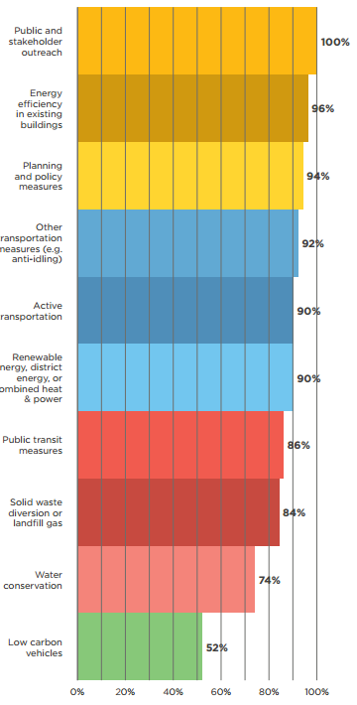
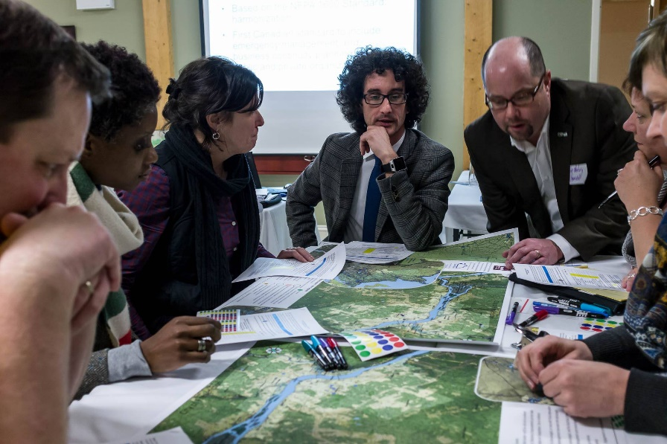
A PATHWAY TO SMART ENERGY COMMUNITIES
www.gettingtoimplementation.ca
Notes:
No standard approach to developing or implementing a CEP // no single definition. However, we have compared CEPs across Canada (in GTI), identified policies in each Province, we are working with pilot communities on a Scorecard, we have produced a bilingual CEP Primer for NB and ON Municipalities, and at least 45% of NB municipalities are advancing an energy and emissions reduction plan. ON provides funding to municipalities to develop CEPs.
CEP typically Led by local government, developed and implemented by the community
A CEP often includes such measures as:
Public consultation/engagement
Energy Efficiency in Buildings
Planning/policy measures
Transportation measures
CEPs typically contain:
A baseline inventory of energy and GHG emissions
Energy conservation and GHG reduction targets
Energy models
Actions to achieve targets
Implementation Strategy
Community and stakeholder support strategies

Slide 13
Energy Efficiency
Notes:
Think Sectors: Corporate, Community residential, commercial, institutional, industrial, transport, waste, etc.
Think Principles: Quest
The successful implementation of Smart Energy Communities on any scale requires astute decision making on both the policy side and the technical side. QUEST has developed the following technical principles in order to guide the effective implementation of Smart Energy Communities.
Energy efficiency and heat conversion, heat pumps

Slide 14
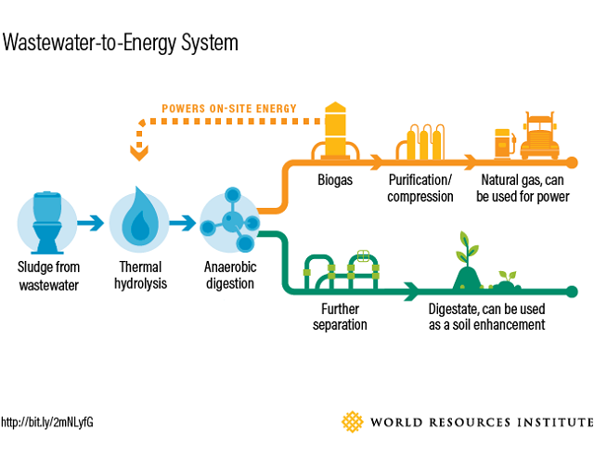
Waste Energy
This Photo by Unknown Author is licensed under CC BY-NC-ND

Slide 15
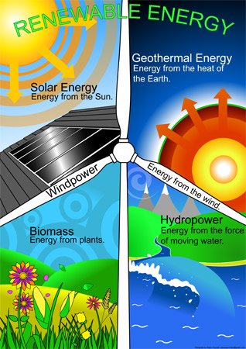
Alternate / Renewable Energy
Notes:
From small scale solar, to solar farms, to wind, to biomass (for district heat and residential heat), to geothermal

Slide 16
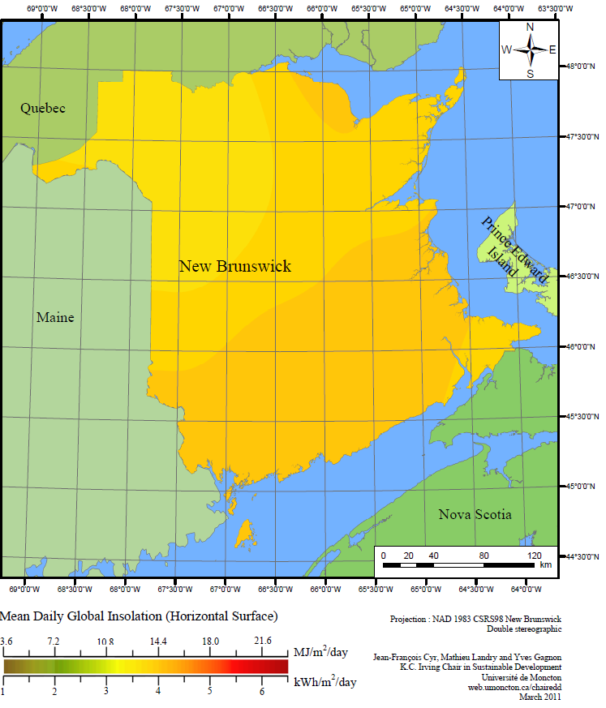
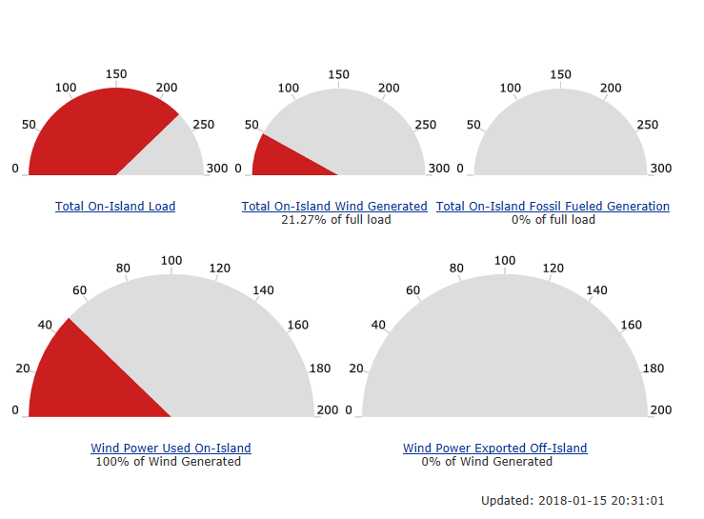
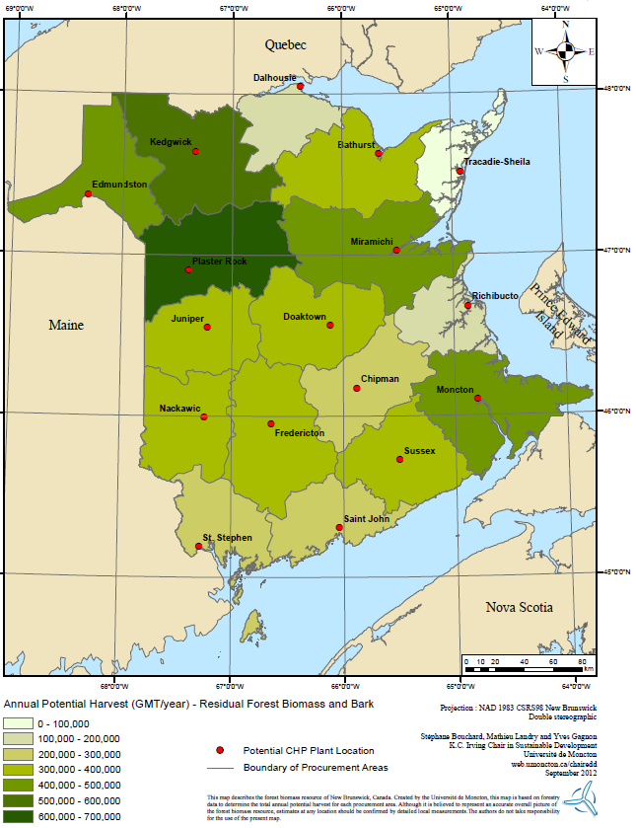
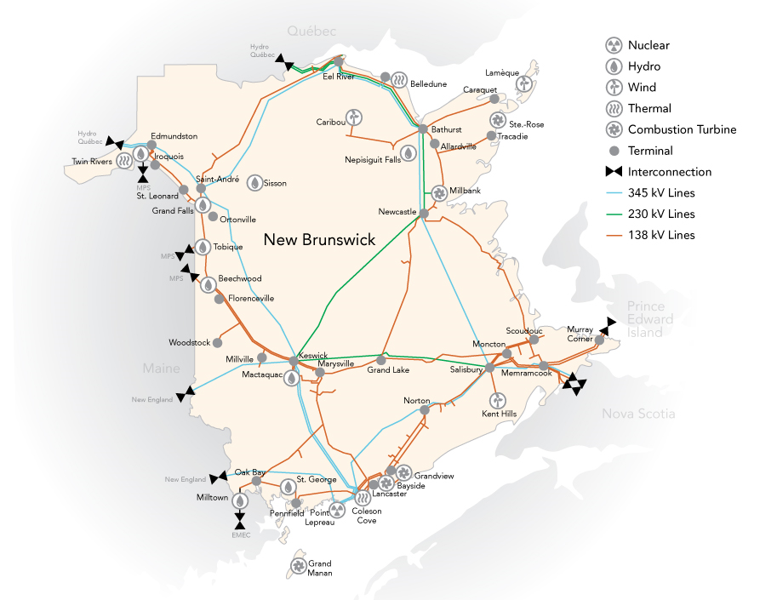
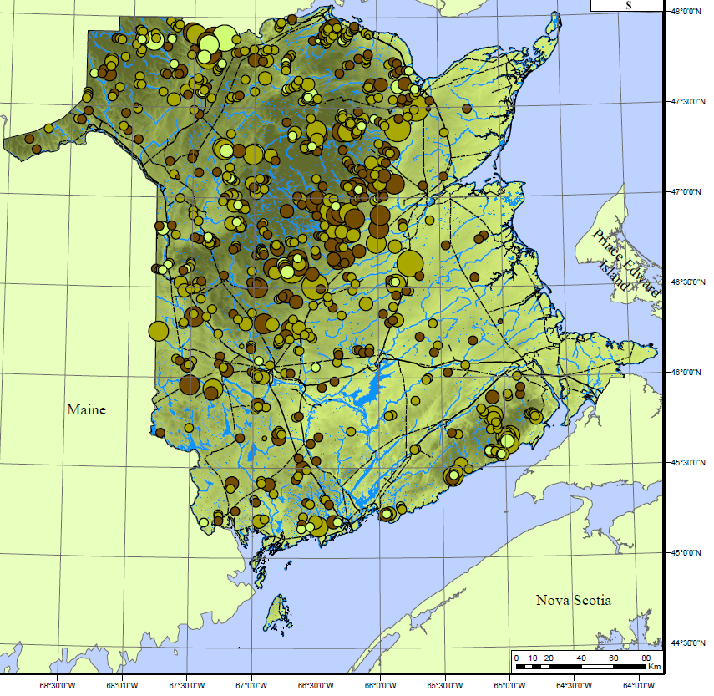
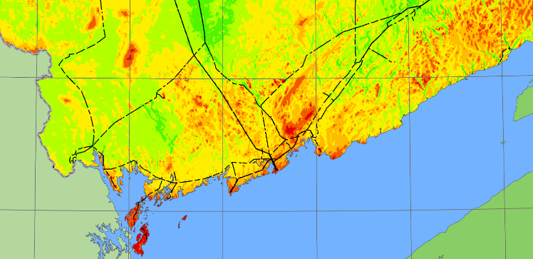
Renewable Energy Resources in New Brunswick
Wind Energy
Biomass Resources
Solar Resources
Wind Resources
Micro-Hydro Resources

Slide 17
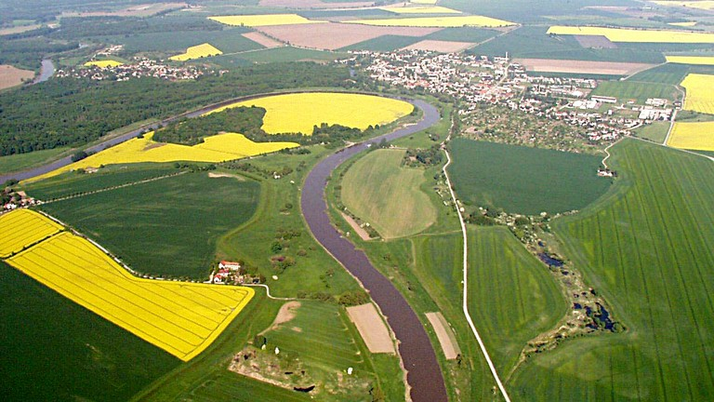
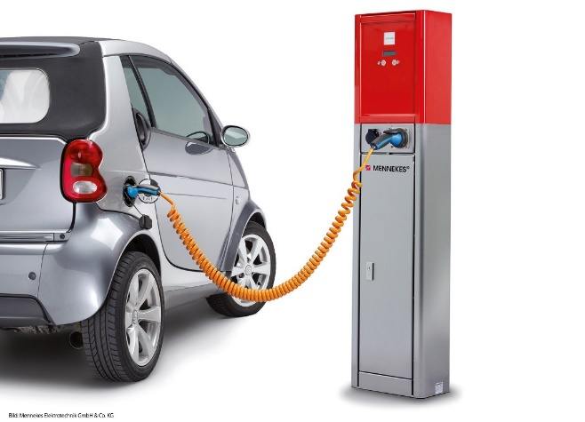
Land Use and Transportation
Notes:
EV charging / car sharing
Anti idling, driver behavior
Land use

Slide 18
SMART ENERGY COMMUNITIES ON THE GROUND
Corporate and Community GHG Inventories (complete)
Development of Local Action Plans with CEP approach, public consultation
Identification of Actions / Quantified Impacts
PCP Milestones 1 to 3
UMNB Climate Change & Energy Initiative
2017 – 2018
11 Municipalities
Notes:
Our panelists will also share SEC perspectives on Energy and Emissions plans/projects
With about 15 interested municipalities to join, there is possibility for another multimunicipal project

Slide 19
SMART ENERGY COMMUNITIES ON THE GROUND
City of Summerside, PEI
Wind-heating pilot program
Stores surplus wind electricity as heat, maximizing wind resource
Replaces customers’ oil/gas/wood/etc. heating with cheaper space and water heating
Notes:
Community-wide example, not a PCP member

Slide 20
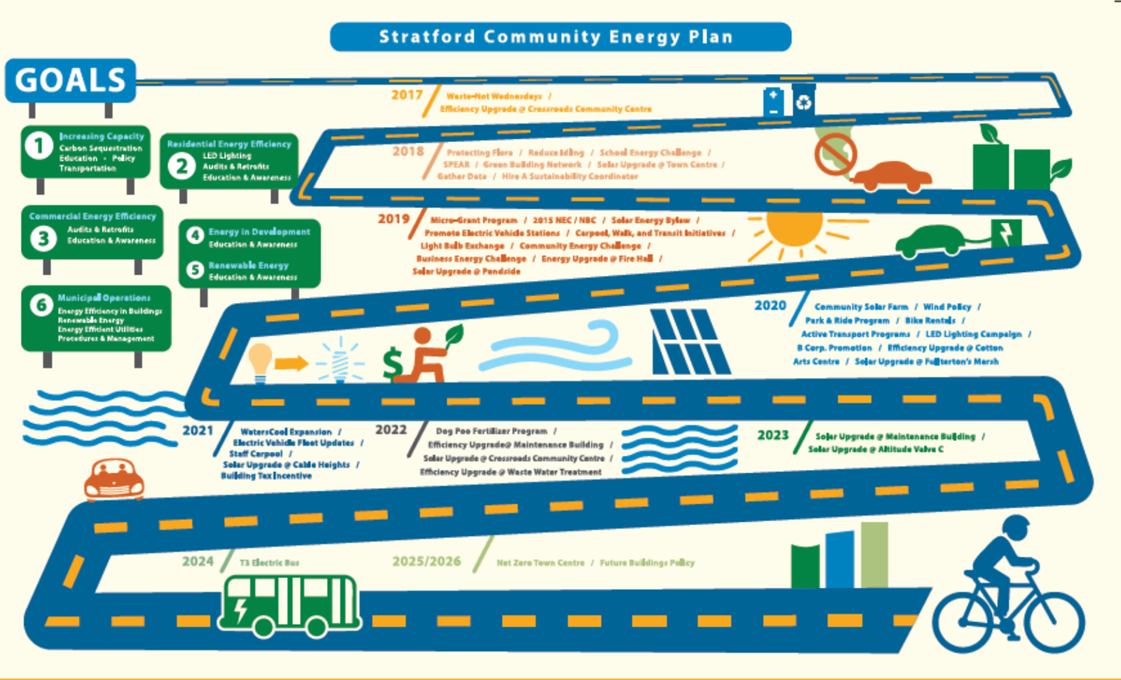
Town of Stratford, PEI
“Stratford’s Community Energy Plan envisions a sustainable community that reduces greenhouse gas emissions and energy consumption through active transportation, education, energy conservation and efficiency, and renewable energy.”

Slide 21
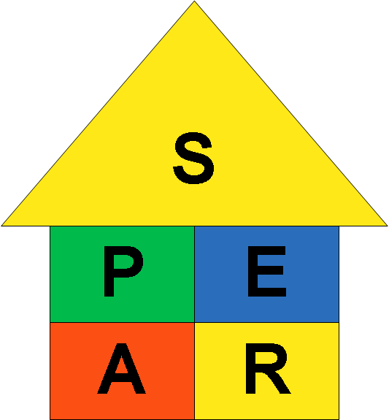
What are we doing right now?
Stratford’s Program for Energy Audits and Renewables (SPEAR);
To provide people with an easy way to make their homes more efficient and allow participants to save money.

Slide 22
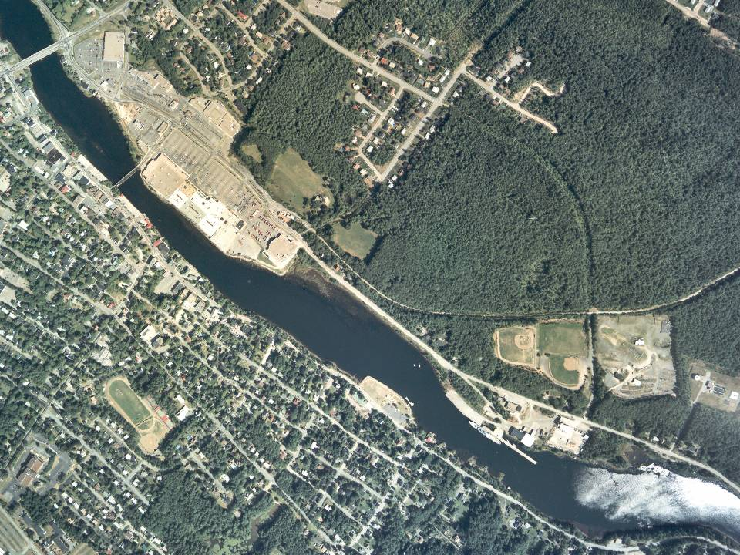
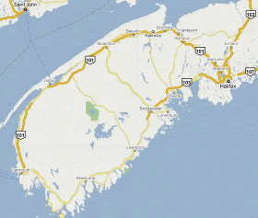
Bridgewater, NS
Population 8200
www.EnergizeBridgewater.ca
22 / 41
Notes:
Poll: has anyone heard of Bridgewater NS?

Slide 23
Energize Bridgewater
Energize Bridgewater is a community‐wide initiative to accelerate the transition of our community toward a “local energy economy”.
The community’s shared vision and commitments are recorded in a Community Energy Investment Plan that will provide practical financial tools to make energy solutions more affordable for residents, businesses, and organizations.
With the launch of the Community Energy Centre, the Energy Partnership and the Living Energy Laboratory, we are working together to accelerate the transition to a local, efficient, renewable energy economy.

Slide 24
Solar City (Halifax)
PACE
Saint John MEEP
District Heat
Mini Split Heat Pump Rental Program
PERTH-ANDOVER
Reinvesting energy savings into social good (free skating)
McCain = biomass residue is used for heat
Dieppe
Sustainable Subdivision Design

Slide 25
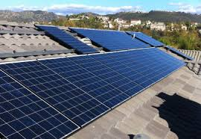
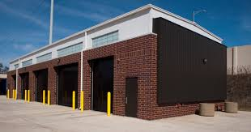
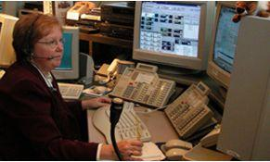
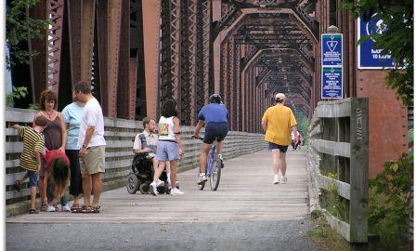
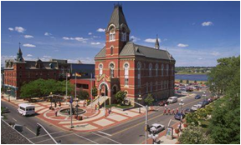
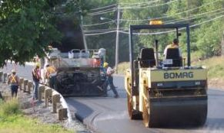
Moving Forward.....
Comprehensive energy Audits for major facilities
Utilizing facility master plan to ID inefficient equipment
Developing EE measures and renewable energy opportunities
Implementing energy storage in conjunction with renewables
Developing GHG reporting
Tracking energy savings from renewable projects and energy efficiency measures
Developing CEP and opportunities for capitalizing on waste energy and district heating
Continuing to invest our savings to further optimize our infrastructure
Building Instantaneous energy monitoring network
Developing load shedding sequences
Monthly reporting on energy performance
City-wide energy management network for monitoring and re-commissioning
Preventative maintenance programs (controls and HVAC)

Slide 26
Smart Energy Networks
Utility and Municipalities working to Connect Renewables, controllable loads, and Fast Ramp Generation.
This Photo by Unknown Author is licensed under CC BY

Slide 27
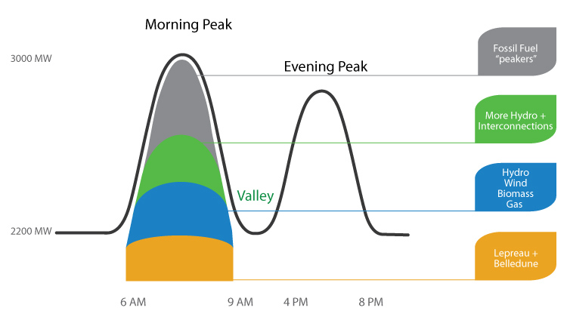
Our Opportunity – Rely less on GHG fuels

Slide 28
Why should local governments act?
Direct or indirect influence over 50% of Canada’s GHG emissions.
Ability to invest in projects that provide communities with:
Play a significant role in charting Canada’s climate ambition.
Reduced municipal and household energy costs
New local economic development opportunities
The opportunity to demonstrate leadership.
Improved health for residents
Notes:
Speaking Notes:
Climate change is arguably Canada’s greatest sustainability issue. As climate change is already affecting many communities, it is also likely to impact citizens and local government services, assets and infrastructure — in the building, energy, transport, water and waste sectors.
While it is imperative for all levels of government to work together to take action on climate change, local governments have control over a significant portion — in fact, about 50%— of our nation’s greenhouse gas (GHG) emissions.
Through their own operations and decision-making powers, local governments have a major impact on the pattern of urban and rural development, transportation, economic activity and consumption of energy resources. As a result, municipalities have both direct control and indirect control over how, where and to what extent GHG emissions are produced:
GHG emissions under the direct control of municipalities include those that arise directly from providing municipal services and operating municipal buildings, fleets and facilities.
GHG emissions under indirect control include those where municipalities play a significant role in determining the level of emissions through municipal planning, public transit access and policy mechanisms, such as building codes and land use regulations — for example, development charges and zoning requirements. In this respect, municipalities shape how GHG emissions are generated through land-use practices, spatial distribution of the economy, transportation systems (transit viability, vehicle use, active transportation rates), the energy efficiency of the community building stock, and some energy supply opportunities.
It is important to note that local governments’ powers stem from provincial legislation and vary from province to province.
Keep Energy Dollars Local! Local governments have the ability to invest in projects that will chart Canada’s future course. Smart investments will provide communities with reduced municipal and household energy costs, new local economic development opportunities, improved health for residents, and an opportunity to demonstrate leadership while improving the attractiveness of a municipality. The opportunity exists for a significant contribution to be made towards climate protection at the local level, through both mitigation work — reducing our greenhouse gas emissions — and adaptation work to ensure that the projects and infrastructure we are investing in contribute to building a resilient community and are designed to withstand new climate norms for storms, precipitation, heat, and wind, etc.
Furthermore, local governments are uniquely positioned to mobilize business and civil society through the use of their public influence, decision-making and purchasing powers to move their community forward on local climate action.
When combined, local governments play a significant role in charting Canada’s climate ambition.

Slide 29
Thank-you!
Eddie Oldfield
Senior Associate, QUEST
Regional Climate Advisor, FCM
Tel. 506-440-3854
Email: eoldfield@questcanada.org

